Slide 1

BRAIN TUMOR PREDICTION USING
CONVOLUTIONAL NEURAL NETWORK (CNN) AND COMPARISON OF VARIOUS MODELS
B. Amarnath (19BD1A050A)
C. Aneesh Krishna Rao (19BD1A050H)
B. Sharan Kumar (19BD1A0507)
G. Ajith Reddy (19BD1A050N)
under the guidance of
Dr. M SRINADH SWAMY
Asst Prof., CSE Dept.

Slide 2
CONTENTS
Abstract
Introduction
SOFTWARE REQUIREMENTS SPECIFICATIONS
LITERATURE SURVEY
SYSTEM DESIGN
IMPLEMENTATION
TESTING
CONCLUSION
FUTURE ENHANCEMENTS
REFERENCES

Slide 3
ABSTRACT
Context: Brain tumor prediction is a challenging task in medical image processing due to the difficulty in accurately classifying tumors compared to normal tissues.
Objective: The objective of the project is to develop a more accurate brain tumor prediction model by comparing different classifiers (logistic regression, random forest, decision tree, Naïve Bayes) with a CNN algorithm.
Method: Various classifiers were evaluated, but to overcome limitations, a CNN model using Keras and TensorFlow was selected. The CNN architecture enables pattern recognition in raw images for improved tumor classification.
Result: The project aims to demonstrate the superior accuracy of the CNN model compared to other classifiers, showcasing the potential of CNNs in accurate brain tumor prediction.

Slide 4
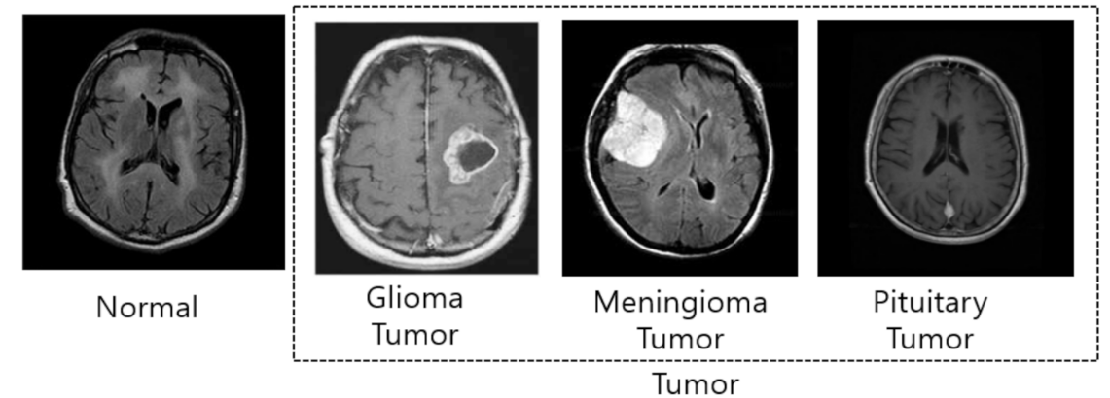
INTRODUCTION
Overview
The main idea of our project:
Predict the tumor in the brain.
There are 3 types of tumors, they are
Glioma.
Meningioma.
Pituitary.

Slide 5
Tumors can be classified using machine learning models like:
Logistic Regression
Decision Trees
Random Forest
Naive Bayes
Convolutional neural network(CNN)
CNN is expected to be the most accurate among these models [2].

Slide 6
Problems with existing system
Logistic Regression is a single layer structure and hence can’t decipher features
Naïve Bayes gives the least accuracy because it assumes that all features are independent.
Decision trees won’t consider the inter feature relationship, therefore results may not be great.
Random forest lacks the flexibility for feature processing and modeling. We have to automate the feature selections which can be tedious.
Proposed system
State-of-the-art Convolutional Neural Network (CNN) is used for prediction.
Other models include Naive Bayes, decision trees, random forests, logistic regression for prediction and are compared with CNN [4].

Slide 7
SOFTWARE REQUIREMENT SPECIFICATIONS
Functional Requirements
Upload the MRI images of brain from local device.
View results consisting of details about brain tumor.
Understand the severity of tumor based on different deep learning models.
Non-Functional Requirements
Accuracy
Reliability
Adaptability
Usability

Slide 8
SYSTEM REQUIREMENT SPECIFICATIONS
Software Requirements
Windows 10
Python (version 3.7.3)
Anaconda version (version 2022.03)
Jupyter Notebook (version v6.5.4)
Hardware Requirements
Intel Core i5 processor
64-bit, quad-core processor
RAM: min 4 GB
Libraries
Numpy,
Pandas,
Matplotlib,
Seaborn,
Sklearn,
Keras,
OpenCV,
Itertools.

Slide 9
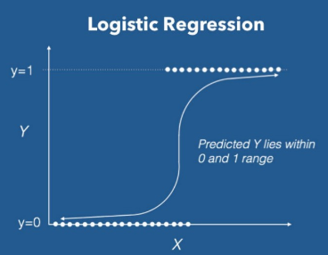
LITERATURE SURVEY
Typical Machine Learning models mentioned above can be used for image analysis but can’t produce efficient results.[1]
No feature extractions.
Deep Learning does feature extraction for us.[3]
SOME TYPICAL ML MODELS
Logistic Regression
Binary class classifier
According to the occurrence of a particular
category of data the outcomes are fixed.
Uses Sigmoid function (value ranges from 0 to 1)

Slide 10
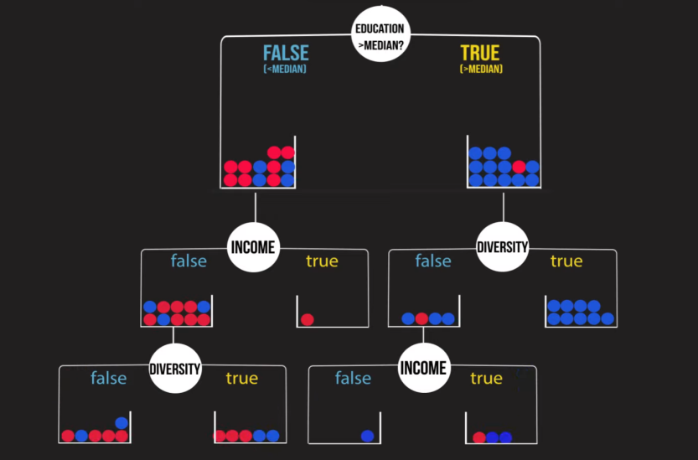
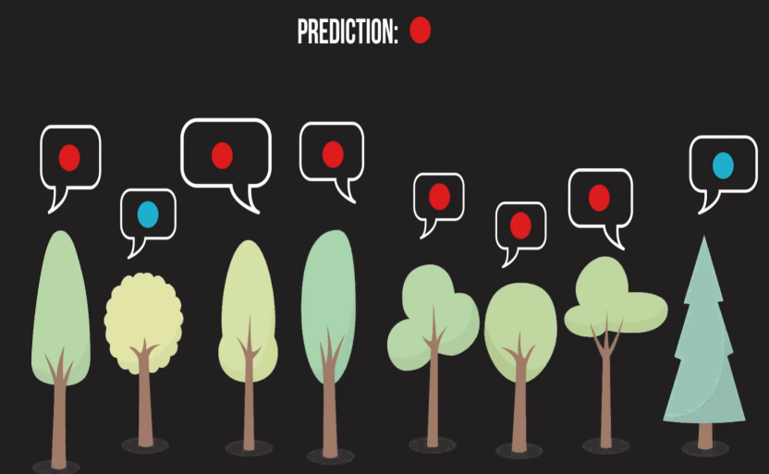
Decision Trees
The decision tree splits the data into
smaller parts.
Performs classification or regression by
recursively asking true or false questions.
Random Forest
It consists of many decision trees .
All the decision trees try to predict the class
label using feature randomness and bagging.
The class label with majority of votes is taken.

Slide 11
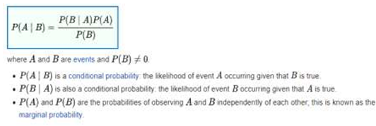
Naive Bayes
It predicts the class label using probabilities
of independent events which are unrelated
to each other.
Convolutional Neural Networks (CNN)
A Neural Network based architecture.
Images are given as input restoring the spacial structure.
Features of healthy brain tissues and tumour tissues are extracted at every hidden layer using kernals.
The layers mainly present are convolutional, ReLu, Pooling and fully connected.
CNN identifies the features and predicts the severity of the tumor in the MRI image of a brain.

Slide 12
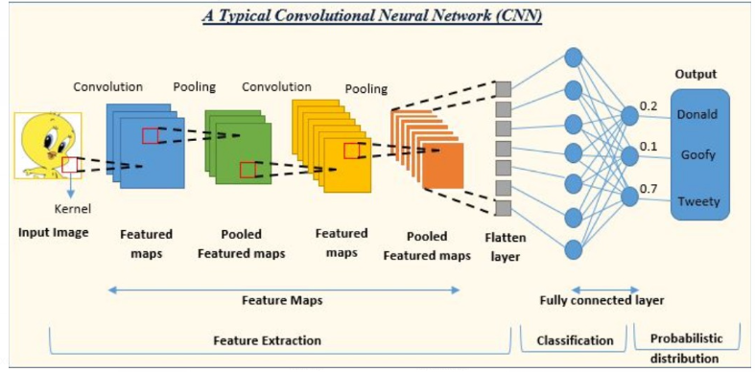
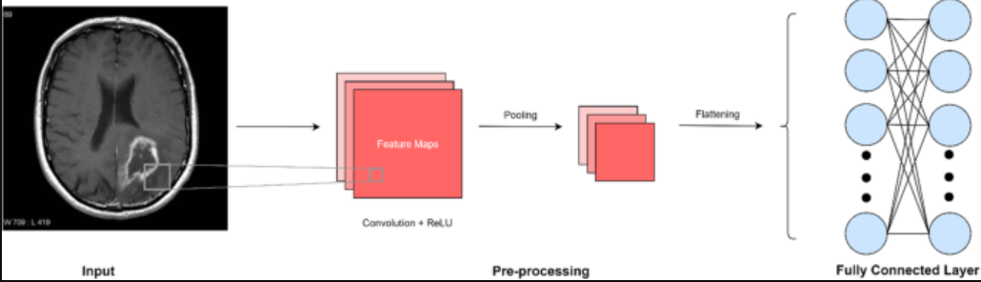

Slide 13
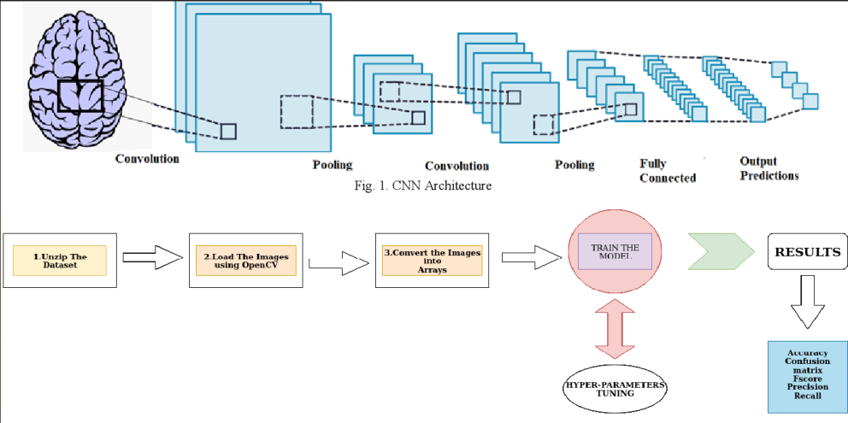
SYSTEM DESIGN
Architecture Diagram

Slide 14
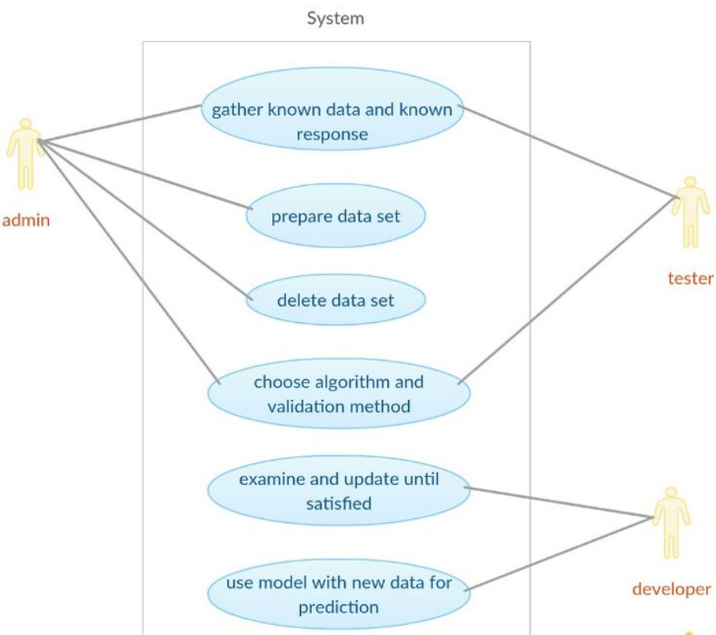
UML Diagrams
Use-case diagram

Slide 15
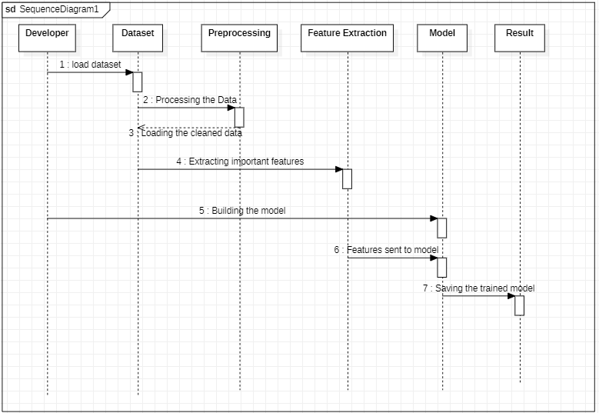
Sequence diagram

Slide 16
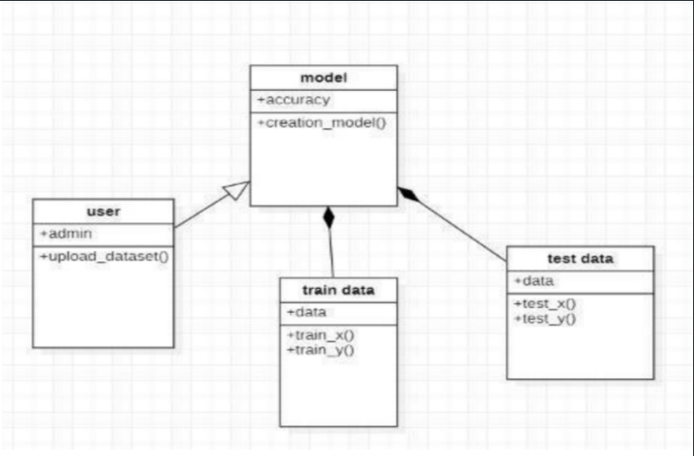
Class Diagram

Slide 17
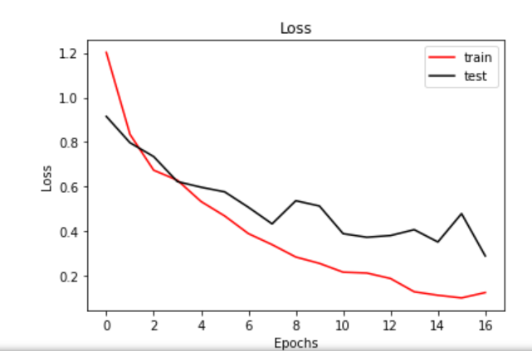
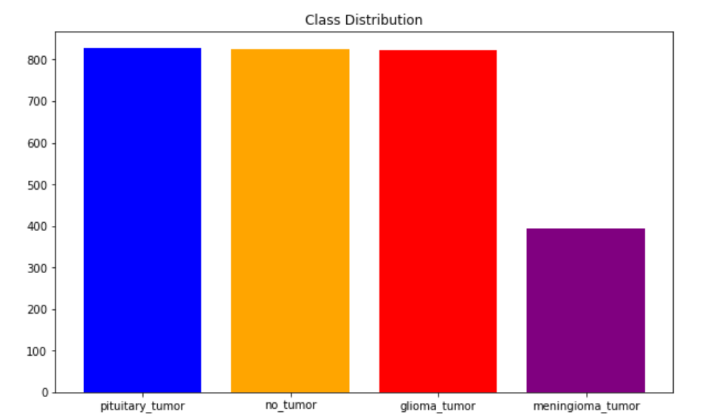
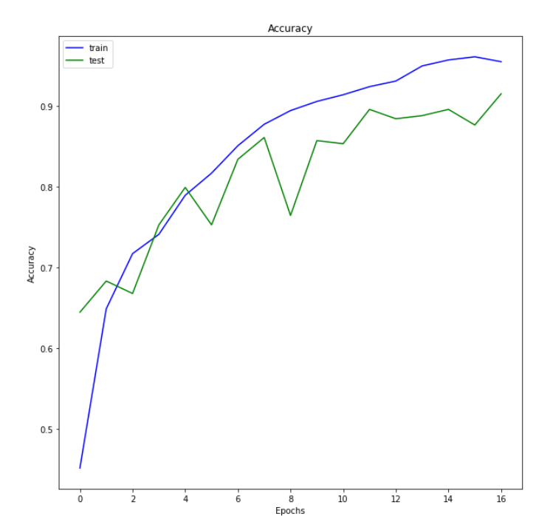
IMPLEMENTATION
Epochs vs Loss Graph
Class Distribution
Epochs vs Accuracy Graph

Slide 18
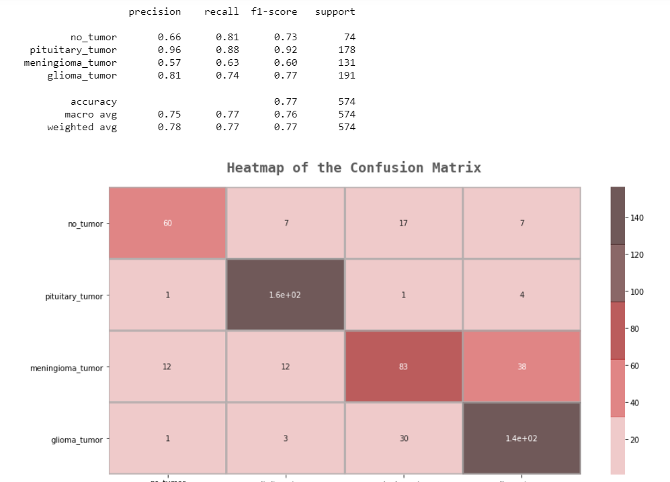
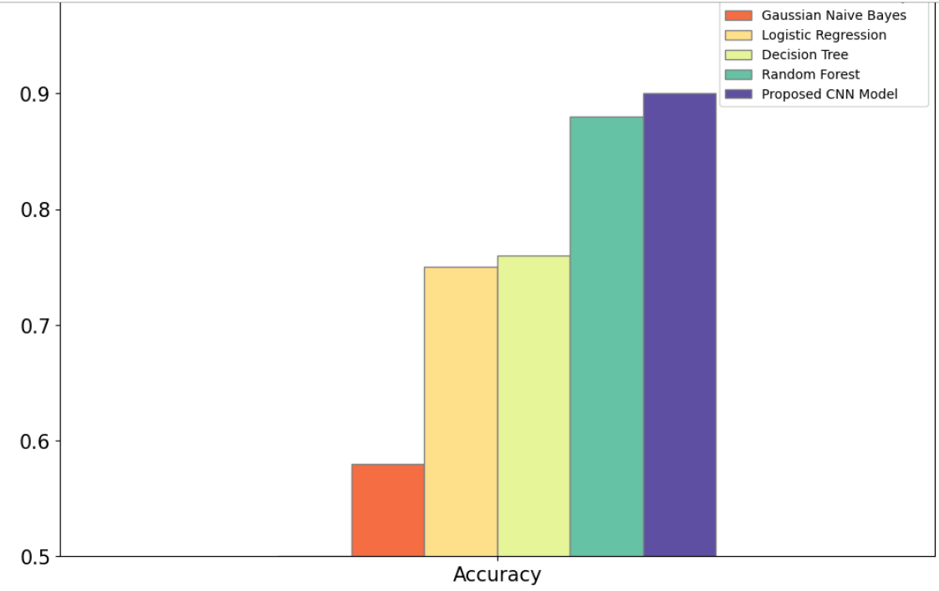
Confusion Matrix
Comparison of Models on Accuracy

Slide 19

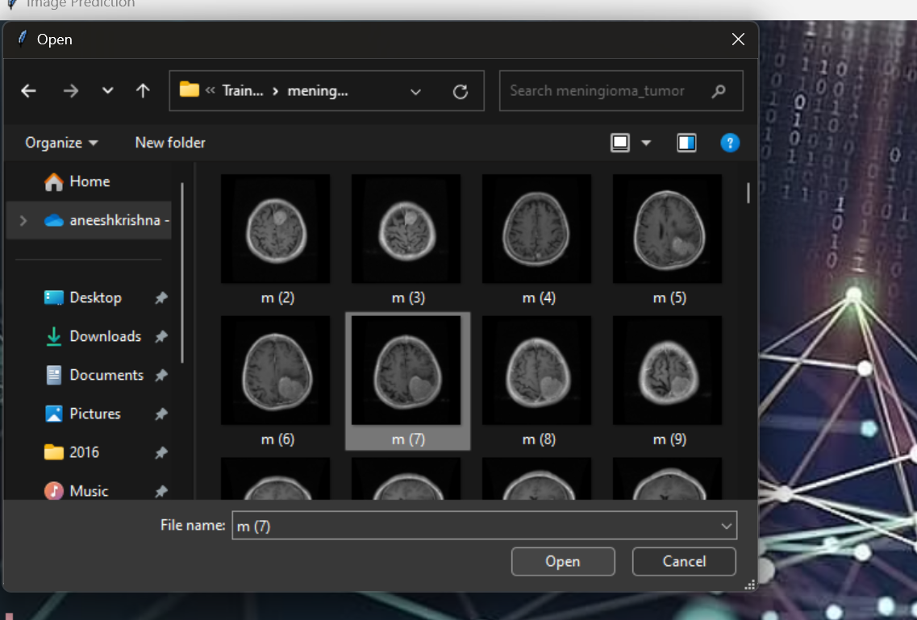
GUI Stage 1
GUI Stage 2

Slide 20
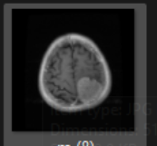
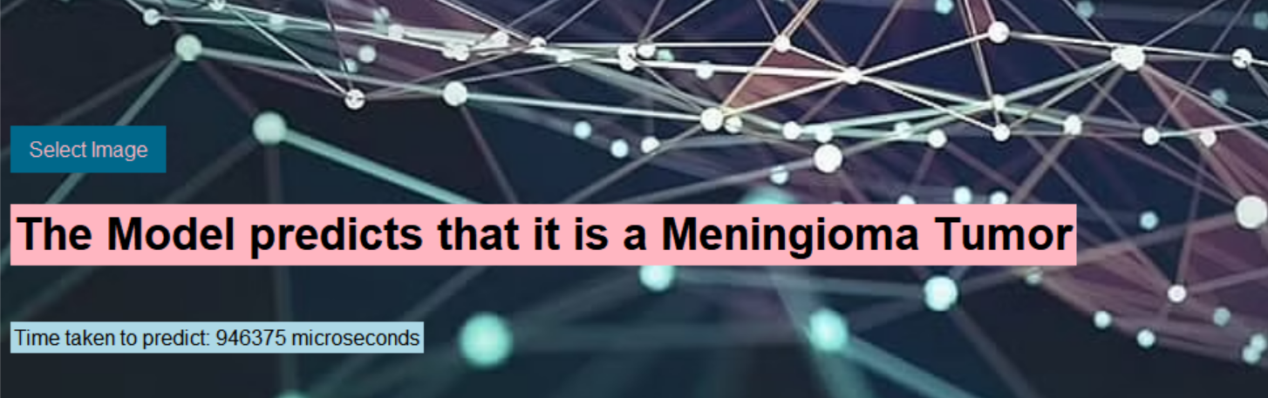
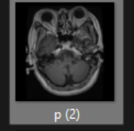
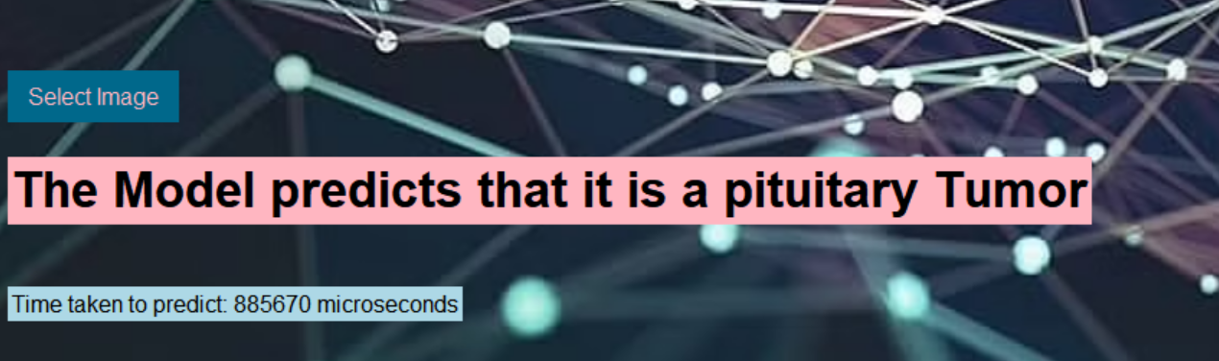
Predictions on Test Images

Slide 21
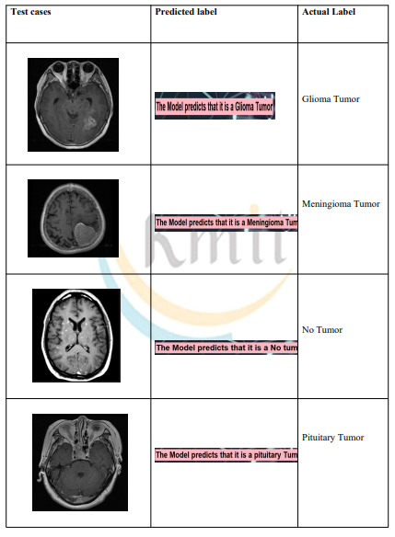
TESTING
Test case scenario for Brain Tumor Prediction

Slide 22
CONCLUSION
Researchers proposed an algorithm for brain tumor prediction and evaluated different models based on their performance and latency.
Logistic regression yielded unsatisfactory results for 2D matrix images.
Decision trees showed slightly higher accuracy, while random forest performed better due to its built-in feature selection, random subspace method, and bagging techniques.
Naive Bayes had the least accuracy due to its assumption of feature independence.
To overcome these limitations, a Convolutional Neural Network (CNN) was proposed and achieved an impressive accuracy of 90%.
CNN's advantages include feature parameter sharing and dimensionality reduction

Slide 23
FUTURE ENHANCEMENTS
Increased dataset size: Better accuracy can be achieved by increasing the size of the dataset used for training the algorithm.
Combining models: Combining different models together can result in a more accurate overall model for brain tumor prediction.
GUI enhancements: Improving the Graphical User Interface (GUI) can provide additional information and features based on user requirements.
Precise tumor location and pixel data: Enhancing the Convolutional Neural Network (CNN) can provide more precise information about the tumor's location and pixel data.
Image segmentation techniques like thresholding or deep learning-based methods can be employed for this purpose.

Slide 24
REFERENCES
[1] Kavitha Angamuthu Rajasekaran and Chellamuthu Chinna Gounder Advanced Brain Tumour Segmentation from MRI Images, 2018.
[2] G. Cinarer and B. G. Emiroglu, "Classification of Brain Tumors by Machine Learning Algorithms", 3rd International Symposium on Multidisciplinary Studies and Innovative Technologies (ISMSIT) 2019.
[3] Mahmoud Khaled Abd-Ellah et al., "A review on brain tumor diagnosis from MRI images: Practical implications key achievements and lessons learned", Magnetic resonance imaging, 2019.
[4] Zhang, J., Sui, D., & Yang, L. (2021). A review on brain tumor diagnosis using machine learning techniques. Frontiers in Computational Neuroscience

Slide 25


